Slide 1
First Law of Thermodynamics

Slide 2

In this Smart Lesson you will learn to:
Explain the first law of thermodynamics.
Recognise the 4 basic types of processes where thermodynamic properties of a system can change according to the first law.

Slide 3

The first law of thermodynamics.
The law of conservation of energy states that in a closed system, energy can neither be created nor destroyed, but only transformed into different forms or transferred.
The first law of thermodynamics states that the change in internal energy (ΔU) of a system equals the heat transferred between the system and its surroundings (Q) plus the work done by or on the system (W).
ΔU=Q+W

Slide 4


Slide 5
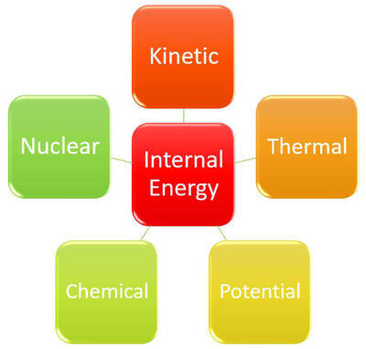
You should recall that the internal energy is equal to the total kinetic energy and potential energy of all the molecules in a system.
The internal energy can be changed by adding or removing heat.
It can also be changed by the system doing work on the surroundings, or work being done on the system.
It is really important to be aware of whether the energy is being increased (+) or decreased (−).

Slide 6
Thermodynamic processes.
There are 4 basic types of processes where thermodynamic properties of a system, usually an ideal gas, can change according to the first law of thermodynamics.
These systems are called:
1. Isovolumetric
2. Isobaric
3. Isothermal
4. Adiabatic
In each system, one property (volume, pressure, temperature or heat) is held constant, whilst the others change.

Slide 7

Isovolumetric systems.
Isovolumetric (=isochoric) refers to a system with a constant volume, usually a rigid container.
As volume is constant, there is no work done on or by the system.
ΔU=Q, (as W=0)
If you add heat to an isovolumetric system, the increase in internal energy leads to an increase in pressure and temperature. Think about what would happen to a can of baked beans accidentally left too close to a camp fire!

Slide 8
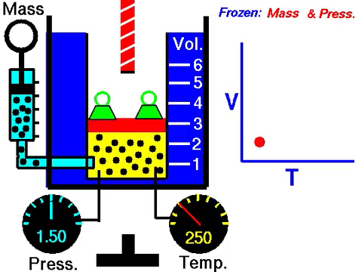
Isobaric systems.
In an isobaric system, the pressure is held constant.
This means, if heat is added to the system, there is an increase in temperature and volume. The change in volume can be used to do work, such as by moving a piston.

Slide 9
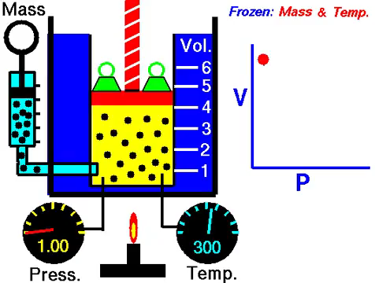
Isothermal systems.
In an isothermal system, the temperature is constant.
This means ΔU=0, which using the first law means:
Q+W=0
This usually occurs when the system is in contact with a large external reservoir. The change in the system will occur slowly enough to allow the system to continue to adjust to the temperature of the reservoir through heat exchange, allowing a constant temperature.

Slide 10

Adiabatic systems.
In an adiabatic system, no heat is allowed to enter or leave.
Q=0
Therefore, ΔU=W
The compression of gas within the cylinder of a car engine is so rapid, it is sometimes considered an adiabatic approximation, as there is no time for heat to transfer out. This is useful in calculating the work done by the engine.

